Slide 1
Dynamics
Moment of Inertia
CG
LabRat Scientific
© 2018
L
W

Slide 2
Moment of Inertia
Inertia is a property of matter
Inertia is a resistance to a change in motion
A Moment is created when a force is applied at some distance from a point of rotation which results in a torque
Moment of Inertia (MOI) is also known as Rotational Inertia
The Moment of Inertia is a “resistance” moment that is caused by mass elements distributed at one or more radii from some point of rotation

Slide 3
Concepts of the Moment and Resistive Moment
The 2 kg mass creates a moment around Point A
A
2 kg
Force = Mass * g
2 kg
B
2 kg
The inertia of the two masses create a “resistive moment” that opposes any “external moment” that is applied about Point B

Slide 4
Moment of Inertia Formulas (small sample)
A
A
Sphere
I_{AA} = 1/12 * M * (a² * b²)
I_{AA} = 4/3 * M * r²
CG
CG
a
b
Notice that these equations involve the square of the length dimensions…
A
A
A
A
r
CG
B
B
CG
L
I_{AA} = 1/12 * M * (3r² * a²)
a
I_{AA} = 1/12 * M * L²
A
I_{BB} = 1/2 * M * r²
A
CG = Center of Gravity (a.k.a. Balancing Point)

Slide 5
So, the Moment of Inertia is similar to Momentum, but not exactly.
With translational motion, the distribution of the mass elements does not come into play when you try to stop the object. It’s the total mass that you have to stop.
With rotational motion, the distribution of the mass elements is critical because the Moment of Inertia is a function of the square of the distance each mass element is from the axis of rotation (as shown in the various equations on the previous slide).

Slide 6
2 kg
CG
2 kg
2 kg
CG
2 kg
Both of these systems have the same total mass and CG location, but the Moments of Inertia are different because the RED masses are located at different distances from the CG (also the center of rotation).
CG = Center of Gravity (a.k.a. Balancing Point)

Slide 7
Examples of how Moment of Inertia affects motion
The ice skater can control his spin rate by moving his arms in and out
Move arms out = increase moment of inertia = reduce spin rate
Move arms in = decrease moment of inertia = increase spin rate
A satellite with a higher moment of inertia will require more fuel in order to change orientation
Go for a spin on a playground merry-go-round
Move towards outside = increase moment of inertia = reduce spin rate
Move towards center = decrease moment of inertia = increase spin rate
A heavier baseball bat will have a higher moment of inertia and will be more difficult to swing (more mass along the radius of the swing)

Slide 8
Measuring Moment of Inertia
MOI’s can be measured using a simple Bifilar Pendulum
A Bifilar Pendulum is a torsional pendulum that uses gravity to provide the oscillatory torque
The period of oscillation is combined with other simple physical parameters to determine the moment of inertia

Slide 9
The Bifilar Pendulum
Oscillates about the CG
Suspension Strings
Length
Distance
Mass
CG
Test Article

Slide 10
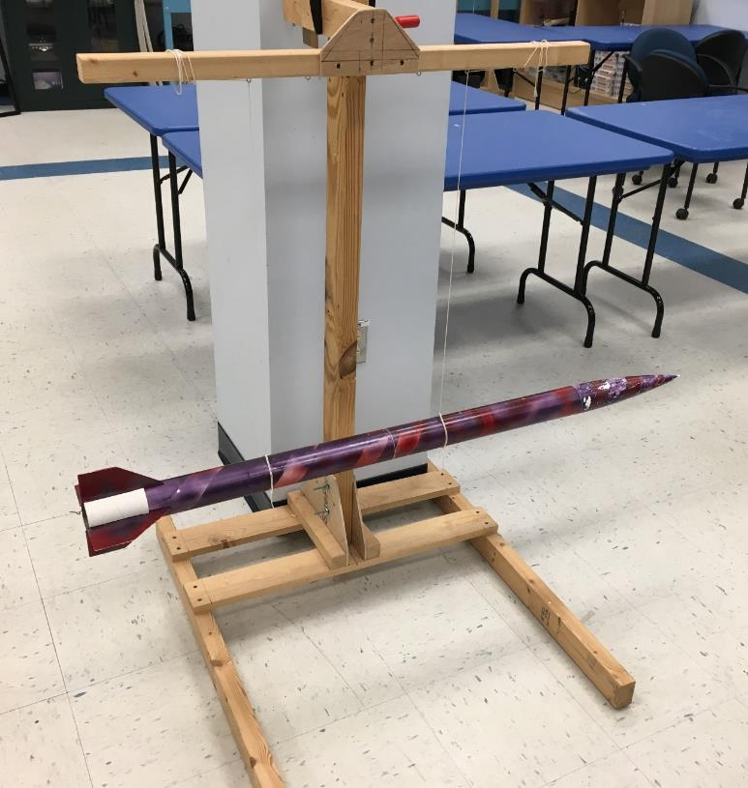
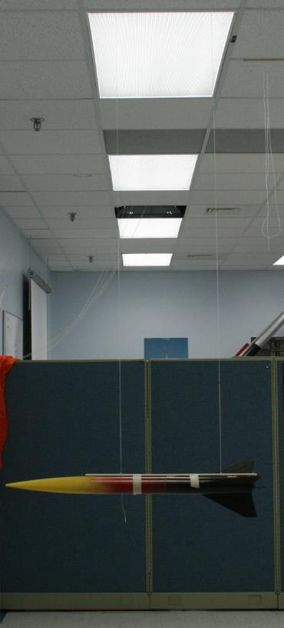
Examples of Simple Bifilar Pendulums
Free Standing Rig
Hanging from Ceiling

Slide 11
Moment (distance² x weight x period²)
of = ---------------------------------------------------
Inertia (16 x pi² x length)
Where:
distance = distance between the strings (meters)
weight = the weight of the test object (Newtons = kg x 9.8 m/sec²)
period = time it takes the pendulum to make one complete oscillation (Sec)
length = length of the strings suspending the object (meters)
Pi = 3.1417

Slide 12
Period of Oscillation
View: Looking down from above the test article when oscillating
The period of oscillation is the time it takes for the test article to swing out, then swing back to its original release position.
T₀ = 0
T₂ = ½ Period
T₃ = Period

Slide 13
Unit Analysis to verify the equation
Moment (m² x kg x m/sec² x sec²)
of = ---------------------------------------------
Inertia (16 x pi² x m)

Slide 14
Unit Analysis to verify the equation
Moment (m² x kg )
of = ---------------------------------------------
Inertia ( )
This equation is valid, the units of Moment of Inertia are indeed kg*m²

Slide 15
Theoretical Calculation of MOI for a Wooden Block
Wood is essentially homogeneous so the CG will be at the middle of the block
We can use a homogeneous wooden block to test the accuracy of the Bifilar Pendulum. A wood 2x4 serves as a good test article.
The following equation from Slide 4 can be used to calculate the Moment of Inertia (MOI) about the block’s CG:
1
MOI = ------- Mass x ( W² + L² )
12
= 0.08 x 0.89 Kg x [ ( 0.035 m)² + (0.51 m)² ]
= 0.08 x 0.89 Kg x 0.26 m²
MOI = 0.0185 Kg * m²
CG
L
W
Mass = 0.89 Kg
W = 0.035 m
L = 0.51 m

Slide 16
Bifilar Pendulum Measurement of Block MOI
Using the Bifilar Pendulum Equation:
D (m)² x W (Kg*m/sec²) x Period (sec)²
MOI = ----------------------------------------------------------
16 x Pi ² x L (m)
(0.46 m)² x (0.89 Kg x 9.8 m/sec²) x (1.12 sec)²
MOI = ----------------------------------------------------------------
16 x 3.1416² x 0.8 m
0.21 m² x (0.89 Kg x 9.8 m/sec²) x 1.25 sec²
MOI = ------------------------------------------------------------
16 x 9.87 x 0.8 m
2.29 Kg*m²
= ------------------- = 0.0182 kg * m²
126.3
L = 0.8 m
D = 0.46 m
M = 0.89 Kg
Trial | Time (sec for 3 oscillations) | Period (sec)
1 | 3.31 | 1.10
2 | 3.37 | 1.12
3 | 3.38 | 1.13
4 | 3.29 | 1.10
5 | 3.40 | 1.13
Data from tests
Average Period = 1.12

Slide 17
Assessment of Theory vs. Experiment
For the wooden block test case:
Theoretical: 0.0185 Kg * m²
Measured: 0.0182 Kg * m²
Conclusion:
The Bifilar Pendulum does a good job at measuring the Moment of Inertia of a wooden block. It can be assumed that it does an equally good job on other test articles.

Slide 18
Practical Application of MOI’s
Effect on Rocket Flight

Slide 19
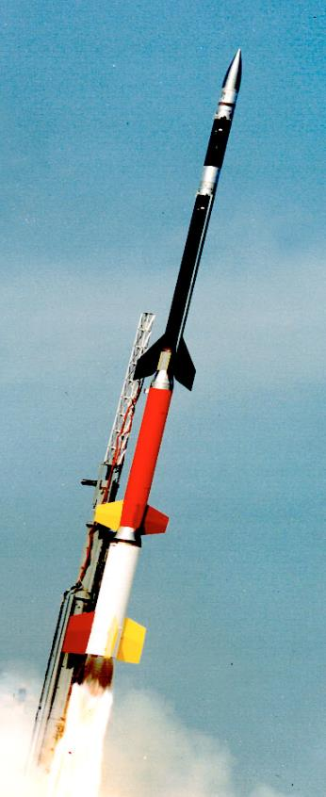
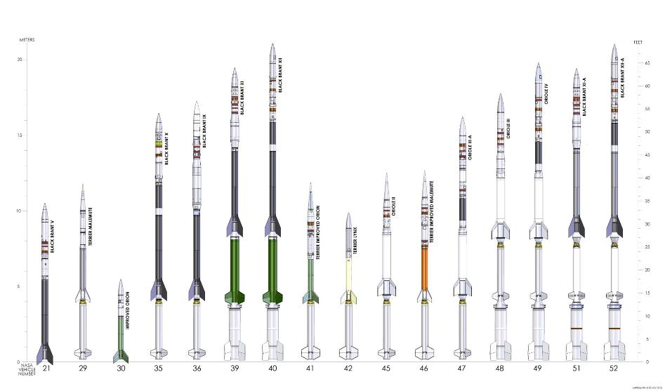
Sounding Rockets are long, slender, suborbital vehicles. They use canted fins to spin the rocket at 4.0 - 5.0 Hz during ascent. The spinning nature of these rockets during ascent and often during the data collection period require knowledge of the MOI of the scientific payloads.
4-stage Sounding Rocket
NASA’s Family of Sounding Rockets

Slide 20
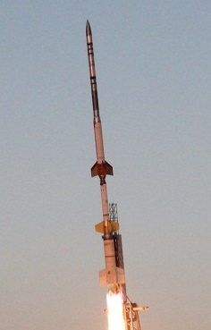
Roll Axis
A NASA Sounding Rocket is analyzed in three axes – Roll, Pitch, and Yaw.
When analyzing a sounding rocket, engineers measure the MOI along the roll axis and a single lateral axis.
Since the sounding rocket is symmetrical about the roll axis, the pitch and yaw moments of inertia are essentially the same.
Pitch Axis
Yaw Axis

Slide 21
Effects of Moment of Inertia on Rocket Flight
A rocket with a higher moment of inertia will react to wind gusts slower
Less wind sensitive (less wind cocking)
Oscillations (once they occur) will take longer to damp out
Can result in higher average angle of attack over the course of the flight, and thus result in higher drag
Higher drag tends to result in lower apogee (maximum altitude)
The MOI’s could result in a pitch rate that could match the spin rate, which may make the rocket enter into roll/pitch coupling
Results in even higher angle of attack which could adversely affect aerodynamic stability
Could lead to rocket break up

Slide 22
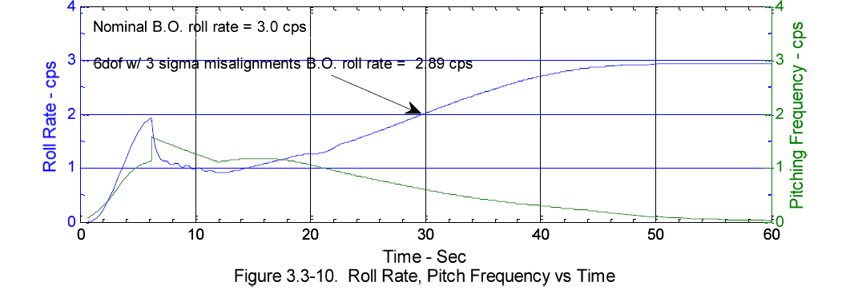
Rocket Roll Rate and Pitching Frequency during first 60 sec of flight
The Roll MOI has an influence on the Roll Rate of the rocket. The Pitch and Yaw MOI’s have an influence on the Pitching Frequency of the Rocket. An engineering analysis that compares the pitch and roll dynamics is critical to ensuring the rocket flies properly.

Slide 23
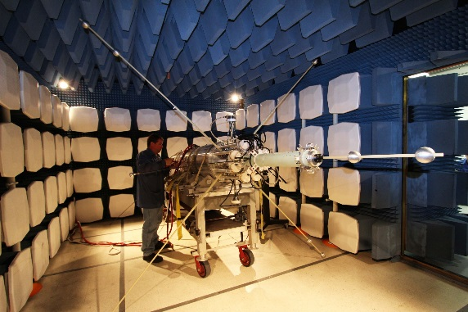
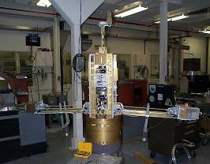
Images of deployable sensor boom systems that change the sounding rocket payload’s Moment of Inertia during the science collection period.
The MOI’s must be known so the performance of the cold gas attitude control system can be assessed.

Slide 24
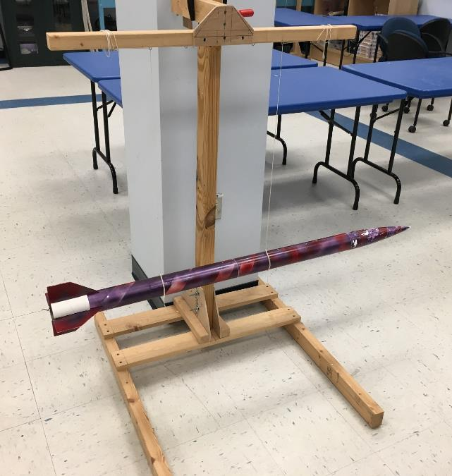
Questions ?

